Slide 1

Key Generation & Key Infrastructure
By:
Anant Bhandari & Harsh Bharucha
2019430004 2019430005

Slide 2
The need for sequence of keys
If an attacker can determine someone else’s key, the attacker can read all traffic enciphered using that key or can use that key to impersonate its owner. Hence , generating keys that are difficult to guess or to determine from available information is critical.
This raises the issue of randomness. Given a set K of potential keys, the probability of a key being guessed is at a minimum when the key is selected at random from the elements of K. The problem of selecting such a key is equivalent to generating a random number between 0 and |K| − 1 .Typically, many keys are required, so a sequence of random numbers is needed.
Notes:
The secrecy that cryptosystems provide resides in the selection of the cryptographic key.

Slide 3
PseudoRandom Number
Pseudorandom numbers is a sequence of numbers generated by an algorithm that is intended to simulate a sequence of cryptographically random number.

Slide 4
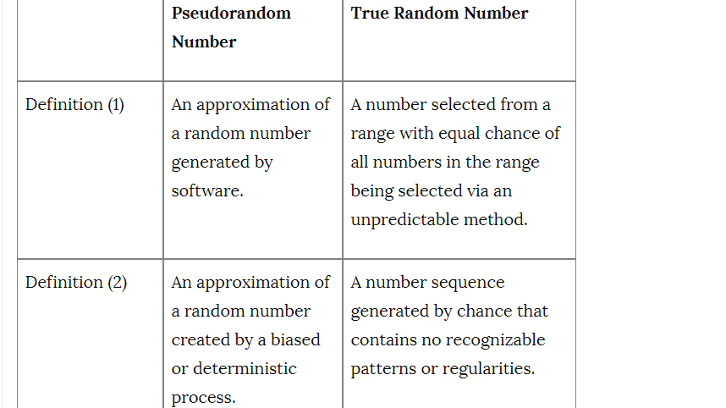
Pseudorandom vs Random Numbers

Slide 5
Linear Congruential Generator
Xk = (AXk−1 +B) mod N where A, B & N are relatively prime numbers.

Slide 6
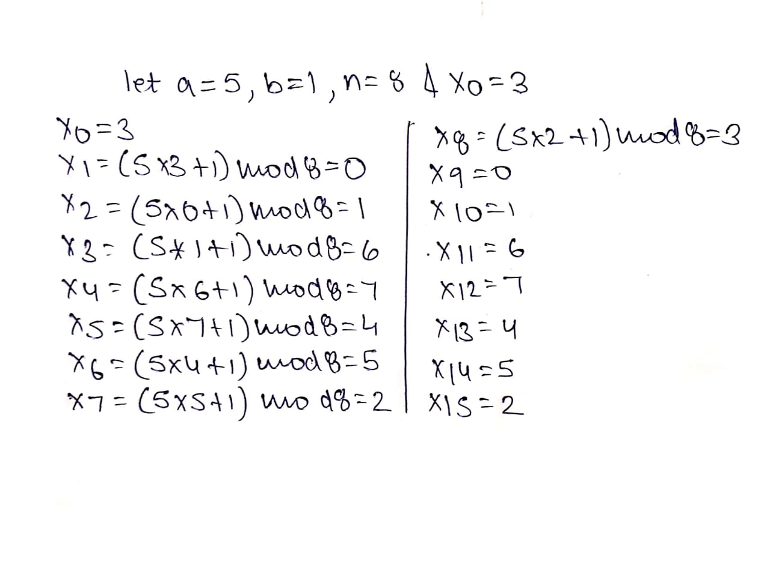
Linear Congruential Generator
Xk = (AXk−1 +B) mod N where A, B & N are relatively prime numbers.

Slide 7
Polynomial Congruential Generator: Xk = (AjX^j k−1 + ... + A1X1 + A0) mod N
best pseudorandom number generators are mixing functions
Example of Mixing Functions:
Advanced Encryption Standard (AES) is a strong mixing function. The AES takes 256, 320, or 384 bits of input (128 message bits and 128, 192, or 256 key bits) and produces 128 output bits. The dependence of the output bits on the input bits is complex and nonlinear.
The Secure Hash Algorithm (SHA) family of hash functions are also strong mixing functions, producing up to 512 output bits from an arbitrary set of input bit.

Slide 8
Cryptographic Key Infrastructures
Certificate
A certificate is a token that binds an identity to a cryptographic key.
Kohnfelder suggests creating a message containing a representation of identity, the corresponding public key, and having a trusted authority sign it. A timestamp t is also added:
CAlice = {eAlice || Alice || t}dCathy

Slide 9
Lets say
Bob wants to communicate with Alice, he obtains Alice’s certificate CAlice. Assuming that he knows the trusted authority Cathy’s public key, he can decipher the certificate. He first checks the timestamp t to see when the certificate was issued. From this, he can determine whether the certificate is too old to be trusted. The public key in the certificate belongs to the subject named in the certificate, so Bob now has Alice’s public key. He knows that Cathy signed the certificate and therefore that Cathy is vouching to some degree that the public key belongs to Alice. If he trusts Cathy to make such a determination, he accepts the public key as valid and belonging to Alice.

Slide 10
One immediate problem is that Bob must know Cathy’s public key to validate the certificate. Two approaches deal with this problem.
Merkle’s Tree Authentication Scheme
Certificate Signature Chains

Slide 11
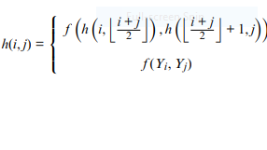
Merkle’s Tree Authentication Scheme
Merkle notes that public keys and associated identities can be kept as data in a file. Changing any of these changes the file. This reduces the problem of substituting faked keys or identities to a data integrity problem. Cryptographic hash functions create checksums that reveal changes to files. Merkle uses them to protect the file.
where i < j

Slide 12
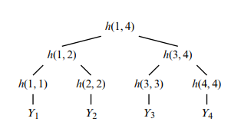
Merkle’s scheme, the ancillary hashes needed to validate a certificate are called the authentication Merkle’s scheme is important because it examines certificate hierarchies and suggests a mechanism that does not use public key signatures to create certificates. The need to have the file available so the root value can be recomputed at will makes this scheme impractical for networks involving large numbers of certificates on widely separated systems.

Slide 13
Certificate Signature Chains
The usual form of a certificate is for the issuer to encipher a hash of the identity of the subject, the public key, and information such as time of issue or expiration using the issuer’s private key. To validate the certificate, a user uses the issuer’s public key to decipher the hash and check the data in the certificate. The user trying to validate the certificate must obtain the issuer’s public key. If the issuer has a certificate, the user can get that key from the issuer’s certificate. But the problem is : how can the issuer’s certificate be validated ?
Two approaches to this problem are - X.509 and PGP.

Slide 14
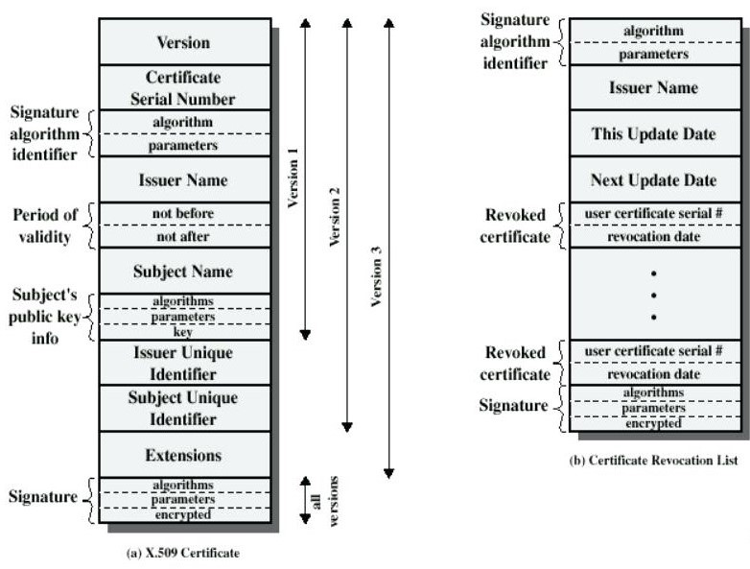
X.509 Certificate

Slide 15
Version - The default is version 1. If the issuer unique identifier or subject unique identifier are present, the value must be version 2. If one or more extensions are present, the version must be version 3.
Serial number - An integer value unique within the issuing CA that is unambiguously associated with this certificate.
Signature algorithm identifier - The algorithm used to sign the certificate together with any associated parameters.
Issuer name - X.500 is the name of the CA that created and signed this certificate.
Period of validity - Consists of two dates: the first and last on which the certificate is valid.

Slide 16
Subject name: The name of the user to whom this certificate refers. That is, this certificate certifies the public key of the subject who holds the corresponding private key.
Subject’s public-key information: The public key of the subject, plus an identifier of the algorithm for which this key is to be used, together with any associated parameters.
Issuer unique identifier: An optional-bit string field used to identify uniquely the issuing CA in the event the X.500 name has been reused for different entities.
Subject unique identifier: An optional-bit string field used to identify uniquely the subject in the event the X.500 name has been reused for different entities.
Extensions: A set of one or more extension fields.
Signature: Covers all of the other fields of the certificate; it contains the hash code of the other fields encrypted with the CA’s private key. This field includes the signature algorithm identifier.

Slide 17
PGP Certificate Signature Chains
PGP is an encipherment program widely used to provide privacy for electronic mail throughout the Internet, and to sign files digitally.
It uses a certificate based key management infrastructure for users’ public keys.
An OpenPGP certificate is composed of packets. A packet is a record with a tag describing its purpose.
Structure of OpenPGP consists of -

Slide 18
Version - OpenPGP is either 3 or 4. Version 3 is compatible with all versions of PGP; Version 4 is not compatible with old (Version 2.6) versions of PGP.
Time of creation - This specifies when the certificate was created.
Validity period (Version 3 only) - This gives the number of days that the certificate is valid. If it is 0, the certificate does not expire.
Public key algorithm and parameters - This identifies the algorithm used and gives the parameters for the cryptosystem used. Version 3 packets contain the modulus for RSA. Version 4 packets contain the parameters appropriate for the cryptosystem used.
Public key - Version 3 packets contain the exponent for RSA. Version 4 packets contain the public key for the cryptosystem identified in field 4.

Slide 19
The information in an Open PGP signature packet is different for the two versions. Version 3 contains the following:
Version - This is 3.
Signature type - This describes the specific purpose of the signature and encodes a level of trust.
Creation time - This specifies the time at which the fields following were hashed.
Key identifier of the signer - This specifies the key used to generate the signature.
Public key algorithm - This identifies the algorithm used to generate the signature.
Hash algorithm - This identifies the algorithm used to hash the signature before signing.
Signature - This contains the encipherment of the hash using the signer’s private key.

Slide 20
Differences between x509 and PGP
X509 certificates are based on the principle of having a CA and anyone who wants to participate in the system would need to have their keys signed by that CA.
In case of PGP certificate, a CA isn’t necessary as it is based on Web of Trust(WOT).
X509 certificate keeps the system centralized.
In case of PGP certificate , it keeps the system decentralized.

Slide 21
Summary
The need for sequence of keys to make communication safer from the both the sender and receiver.
Pseudorandom numbers is produced by a deterministic and a bias process.
best pseudorandom numbers are produced by strong mixing functions.
Merkle : public keys and associated identities can be kept as data in a file.
Certificate is a token that binds an identity to a cryptographic key.
X509 is used in internet protocols like TSL, SSL and also used in offline applications like electronic signatures.
PGP is found to be useful in securing Email data and data stored in vulnerable places like cloud.

Slide 22
Thank You………..

Slide 23
A sequence of cryptographically pseudorandom numbers is a sequence of numbers generated by an algorithm that is intended to simulate a sequence of cryptographically random num.
randomness is important in cryptography to ensure secret keys are random, security against attacks, privacy and anonymity, and to ensure unpredictability. This can only be achieved by using high quality random numbers hard for computers to generate.

Slide 24
A security professional should know what makes a good PRNG. There are four properties any good PRNG should have:
Uncorrelated Sequences – No sequence of any given link should be correlated to any other sequence of the algorithms output. One cannot take a given stretch of numbers (say 16 bits) and use that to predict subsequent bits.
Long Period – Ideally the series of digits (usually bits) should never have any repeating pattern. However, the reality is that there will eventually be some repetition. The distance (in digits or bits) between repetition’s is the algorithm output period. The longer the period the better the more effective the PRNG (James, 1990; Ripley, 1990).
Uniformity – In cryptographic applications, the output of a PRNG will most likely be represented in binary format. There should be an equal number of 1’s and 0’s (Ripley, 1990), though not distributed in any discernable pattern. The sequence of random numbers should be uniform, and unbiased. If you have significantly more (or significantly less) 1’s than 0’s then the output is biased (Soto, 2012).

Slide 25
Computational Indistinguishability – Any subsection of numbers taken from the output of a given PRNG should not be distinguishable from any other subset of numbers in polynomial time by any efficient procedure. The two sequences are indistinguishable. That does not, however mean they are identical. It means there is no efficient way to determine specific differences.

